Slide 1
E-TOURISM APPLICATION:
Presentation can be done in many ways but few methods are the:
1.Log in module
2.Searching module
3.Purchase module
4.Payment module
5.Delivery and logistic module
6.Adding products to the portal to implement

Slide 2
AIM: TO VERIFY AND TEST THE TEST CASES AND TEST SCENARIO FOR THE E -ONLINE TOURISM APPLICATION:

Slide 3
REQUIREMENTS:
1.LOG IN MODULE:
USER NAME:
PASSWORD:
PAYMENT
TO SELECT PLACE TO GO
OVERALL REVIEW

Slide 4
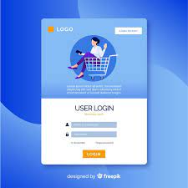
1.Log In module for the e-shopping application

Slide 5
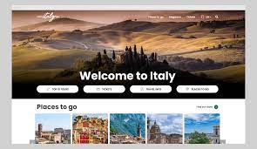
Searching module:

Slide 6
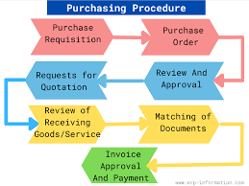
Purchase module:

Slide 7
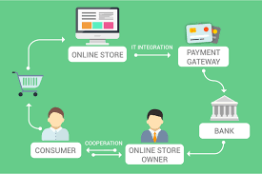
Payment module:

Slide 8
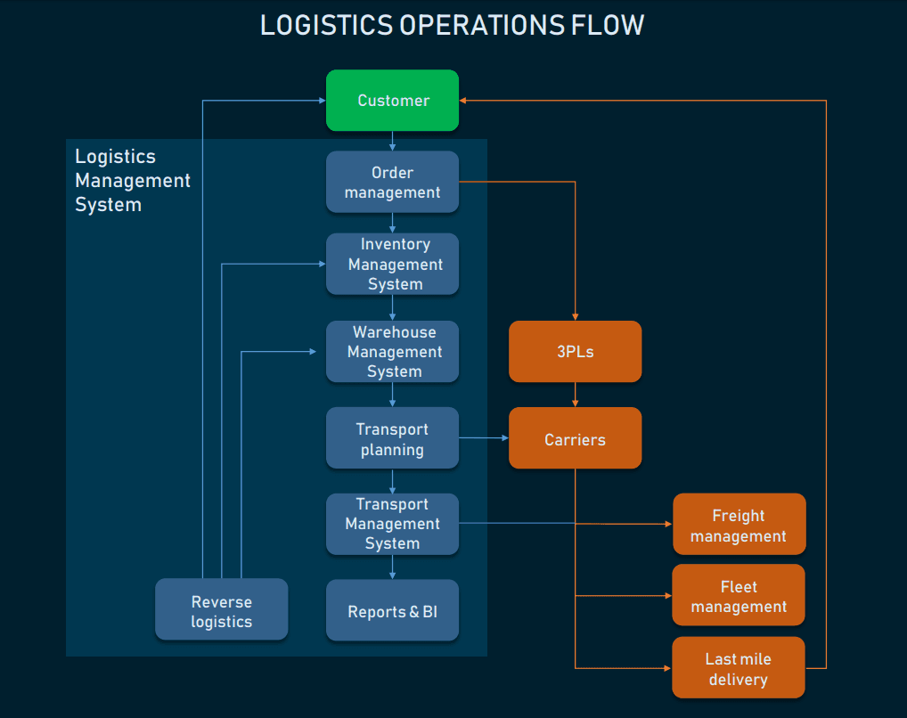
Delivery and logistic module:

Slide 9
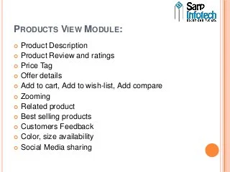
Adding products

Slide 10
E-Online TOURISM APPLICATIONS :
Online TOURISM is a form of electronic commerce which allows consumers to directly buy goods or services from a seller over the Internet using a web browser or a mobile app. Consumers find a product of interest by visiting the website of the retailer directly or by searching among alternative vendors using a shopping search engine, which displays the same product's availability and pricing at different e-retailers. As of 2020, customers can shop online using a range of different computers and devices, including desktop computers, laptops, tablet computers and smartphones.
Like you plan your trips to make them fun, plan your development process too to make that web app successful. And to help you with the same, we present you the following points which you should keep in mind before you take your first step in the process:

Slide 11
Test cases for E-TOURISM applications :
Verify that the user is able to navigate through all the products across different categories.
Verify that all the links and banners are redirecting to correct product/category pages and none of the links are broken.
Verify that the company logo is clearly visible.
Verify that all the text – product, category name, price, and product description are clearly visible.
Verify that all the images – product and banner are clearly visible.
Verify that category pages have a relevant product listed specific to the category.
Verify that the correct count of total products is listed on the category pages.
Search – Verify that on searching all the product satisfying the search criteria are visible on the search result page.
Search – Verify the more relevant product for the search term is displayed on the top for a particular search term.
Search – Verify that count of products is correctly displayed on the search result page for a particular search term.

Slide 12
Test cases for E-TOURISM application:
Verify that there is a portal to add new flights in the system.
Verify that on filling flight details like flight name, code, from and to destinations, capacity, timings, and frequency etc, new filghts get successfully added in the system.
Verify that users can search for flights by name, from-to airports or flight code for checking their status and timings.
Verify that search results have flight details, timings and availability.
Verify that clicking the search results open complete details for flight.
Verify that the user should see realtime flight status of availability of seats.
Verify that the user is presented with a graphical view of the airline’s sitting arrangement along with seat number and availability status.
Verify that the pricing of different types of seats is displayed to the users.
Verify that the user can also cancel the tickets booked by entering the mandatory details and the amount after deducting the cancellation fee gets refunded back to user.
Verify that after cancellation the seat’s status is updated to available

Slide 13
TEST CASE SCENARIO FOR E-TOURISM APPLICATION:
Tourists might plan a vacation by selecting several attractions and deciding later which activities they will actually do. This tourist metaphor represents good advice for software testers; it lets us slice our application's functionality into test cases.
But here is where the cartography metaphor breaks down. Tourists select attractions and activities based on personal preferences and their specific interests. Such subjectivism isn't necessarily a good thing for Google testers where we desire some optimization to our effort or, barring that, at least some guidance and repeatability. Do we simply leave test selection up to the individual or do we attempt to build a knowledge base of techniques that work?

Slide 14
Positive test scenario for E-TOURISM application:
Verify that there is a portal to add new flights in the system.
Verify that on filling flight details like flight name, code, from and to destinations, capacity, timings, and frequency etc, new filghts get successfully added in the system.
Verify that users can search for flights by name, from-to airports or flight code for checking their status and timings.
Verify that search results have flight details, timings and availability.
Verify that clicking the search results open complete details for flight.
Verify that the user should see realtime flight status of availability of seats.
Verify that the user is presented with a graphical view of the airline’s sitting arrangement along with seat number and availability status.
Verify that the pricing of different types of seats is displayed to the users.
Verify that users can successfully select single or more than one seat.
Verify that the user can not select or is not permitted to select seats that are already booked or not allowed for booking.

Slide 15
The negative test scenario for E-TOURISM application:
Verify that the user is able to proceed with a negative number like (-1,-2,-3….)
Verify if the cart is editable then check that the user is able to enter floating numbers
Verify if the cart is editable then check that the user is able to enter special characters
Verify that the user is able to proceed with an empty cart or not
Verify that each items’ price on the shopping cart page
Verify that all item’s total prices on the shopping cart page

Slide 16
The conclusion:
Technology has made significant progress over the years to provide consumers a better online shopping experience and will continue to do so for years to come. With the rapid growth of products and brands, people have speculated that online shopping will overtake in-store shopping.
E-TOURISM is not an IT issue but a whole business undertaking. Companies that use it as a reason for completely re-designing their business processes are likely to reap the greatest benefits. Moreover, E-Commerce is a helpful technology that gives the consumer access to business and companies all over the world.
rtar store. At the end, it has been a win-win situation for both consumer and sellers of it.

Slide 17
THANK YOU

